Slide 1

Localization, Navigation and Smart Mobility
Prof. Monica Nicoli
Prof. Mattia Brambilla
Dipartimento di Elettronica, Informazione e Bioingegneria Politecnico Di Milano

Slide 2
Vehicle localization in a racetrack
Group members:
Mohammadreza Zamani
Fateme Asadi
Sahar Abasi
Asal Abbas Nejad Fard

Slide 3
Index
Introduction
Methodologies
Data analysis
Raw data visualization
AOA-Only
TDOA-only
TDOA + AOA

Slide 4
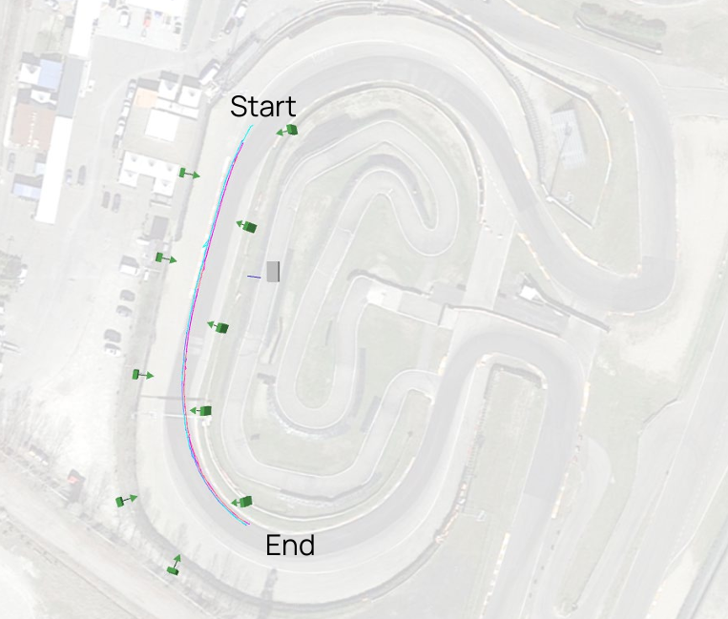
Introduction
This project focuses on localizing a moving vehicle using 10 UWB antennas from the Ubisense Dimension 4 system. The goal is to estimate the vehicle’s position using TDoA and AoA measurements, sampled at 10 Hz. Data is processed in MATLAB, and different localization methods (TDoA-only, AoA-only, and combined) are compared against GPS RTK ground truth. The analysis highlights accuracy, visualization, and parameter tuning to select the best-performing approach.

Slide 5
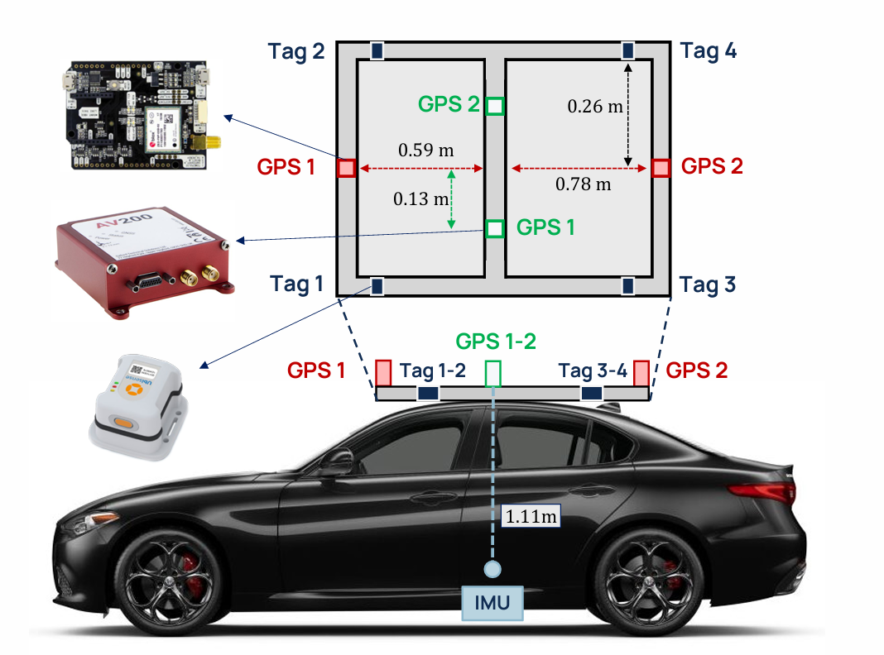
Vehicle Setup The test vehicle was equipped with two GPS RTK modules (GPS 1 and GPS 2) to provide accurate ground truth and orientation reference. Four UWB tags (Tag 1–4) were mounted at known positions on the vehicle to interact with the external UWB antenna network and provide TDOA and AOA data. An onboard IMU was also included to record motion-related measurements. The relative distances between sensors were pre-calibrated and used to support localization accuracy.

Slide 6

Problem Statement: Accurate vehicle localization in complex environments remains a challenging task. This project investigates how Ultra-Wideband (UWB) signals, specifically TDoA and AoA measurements, can be leveraged to estimate a vehicle’s position, and evaluates multiple algorithms to improve accuracy and robustness compared to GPS RTK ground truth.

Slide 7
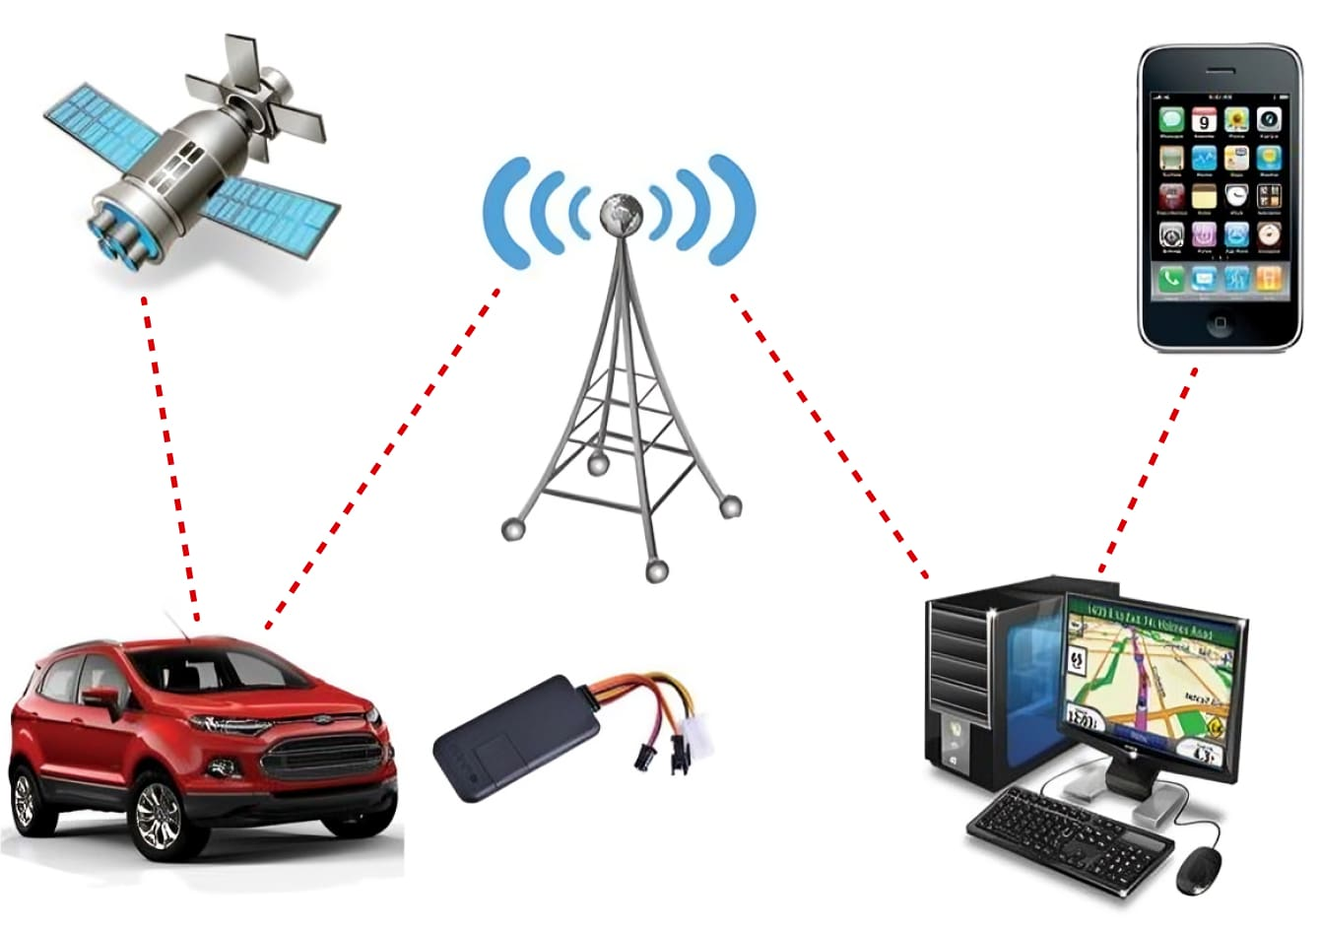
Methodologies overview Data Analysis: Load and visualize TDoA, AoA, antenna positions, and GPS ground truth data. AOA Preprocessing: Convert raw azimuth and elevation from local antenna frame to global angles using yaw and pitch. Localization Methods: Implement and compare TDoA-only, AOA-only, and hybrid (TDoA + AOA) approaches. Tracking Algorithm: Apply filtering (e.g., Kalman Filter, EKF,Hampel) to improve dynamic position estimation. Performance Evaluation : Assess accuracy using RMSE and compare results with GPS RTK ground truth.

Slide 8

Data analysis the raw measurements from the dataset were analyzed using a custom MATLAB script. TDoA values (channels 1–9) and AoA azimuth/elevation angles were plotted over time. The positions of the UWB antennas were visualized in 3D space, along with static and animated AoA rays. This analysis provided an understanding of signal quality, spatial distribution of APs, and angular coverage, helping identify potential anomalies in the measurements.

Slide 9
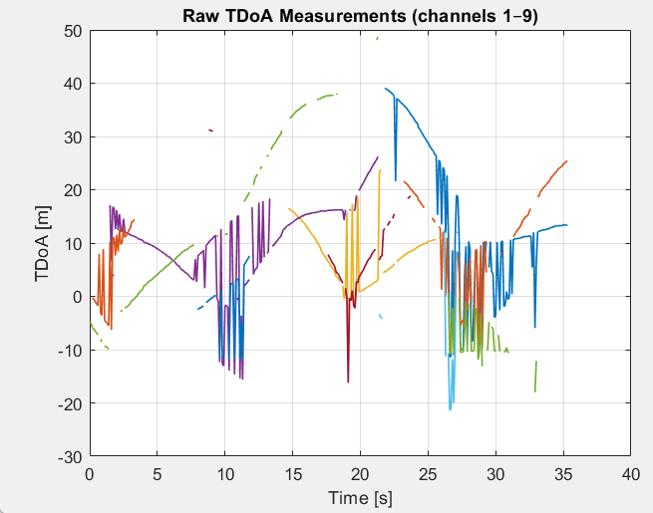
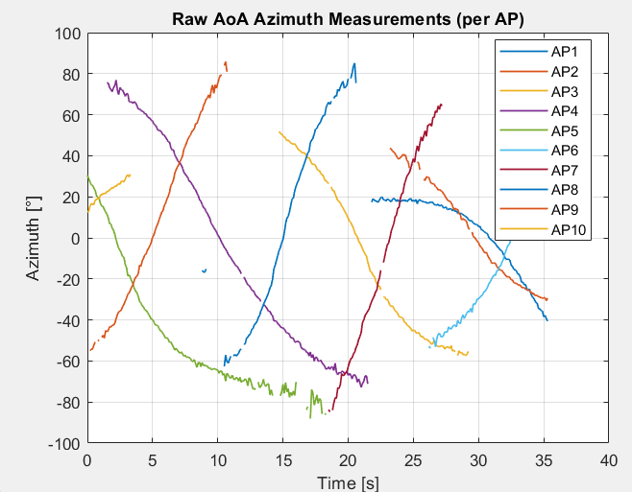
Raw TDoA Visualization
The first 9 TDoA channels were visualized to assess data quality. The plot shows gaps, noise, and sudden jumps, indicating the presence of measurement anomalies. These issues highlight the need for preprocessing before localization
Raw AoA Azimuth Visualization
We visualized raw azimuth data from all 10 UWB antennas, converting angles to degrees for clarity. Most channels display smooth, continuous trends aligned with vehicle motion. However, some discontinuities (missing data) are present and must be addressed in later processing steps.

Slide 10
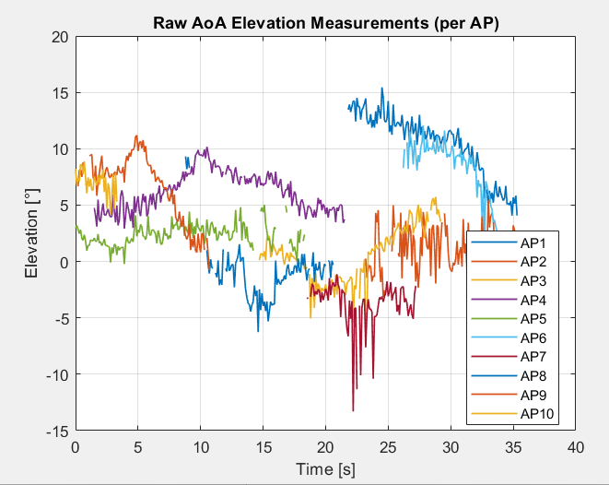
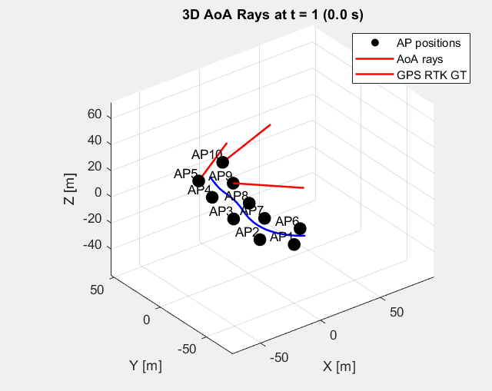
Raw AoA Elevation Analysis
The raw AoA elevation angles, expressed in degrees, are visualized for each AP. The elevation data appears relatively stable across antennas, with some channels showing noise and discontinuities. These variations can impact localization precision and require filtering or correction in the preprocessing phase.
Static AoA Geometry (3D View)
To explore the geometric setup, a static 3D visualization was created showing AoA rays at a specific time step. Rays were drawn from each AP using azimuth and elevation angles, illustrating the direction of arrival. This helps evaluate angular coverage and alignment with the GPS RTK ground truth path.

Slide 11
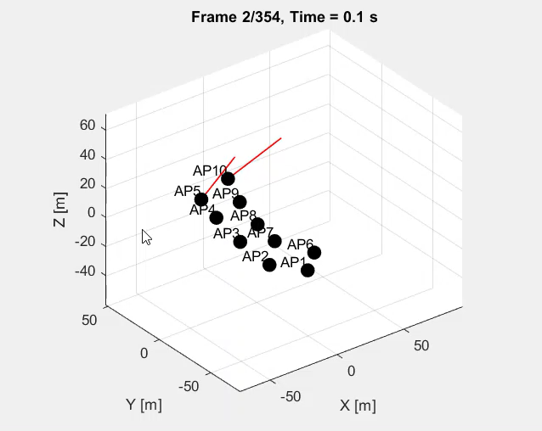
The 3D animation Illustrates how AoA rays from active APs evolve over time, partially aligning with the ground-truth trajectory. At the final frame, only a subset of APs provides usable directional data, reflecting the time-varying signal visibility and AP relevance.
Play video

Slide 12
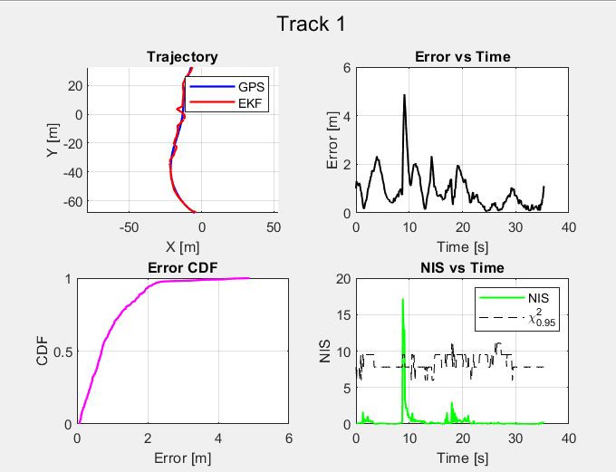
AOA-Only, using EKF (Track 1: with Obstacle)
Methodology We applied a 2D AOA-only EKF using azimuth data from 10 APs, corrected with their yaw angles. The EKF used a constant velocity model, with initial positions estimated via weighted least squares. The loop included state prediction, nonlinear update using AoA, and adaptive noise tuning based on NIS.
Trajectory The EKF trajectory closely follows the ground truth, with small deviation near obstacle zones
Error vs Time Error peaks (~5m) correspond to occlusions or l ow-AoA visibility, but quickly stabilize Error CDF ~90% of localization errors are below 2 meters, showing robustness of the EKF NIS vs Time Most innovations are within χ² bounds. A few spikes suggest inconsistency in high-noise regions.

Slide 13
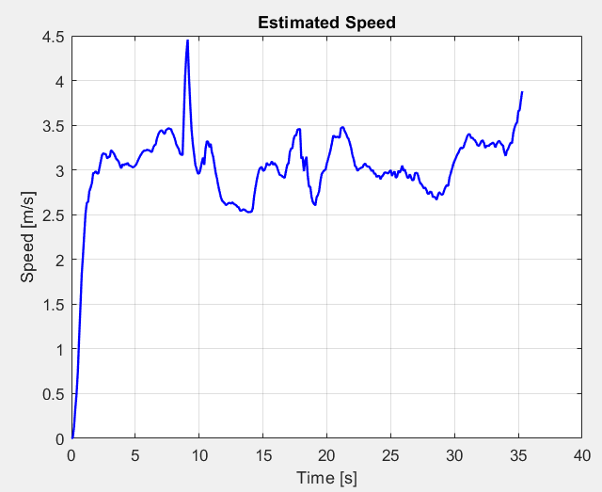
AOA-Only, using EKF (Track 1: with Obstacle)
Velocity Estimate The speed remains mostly stable between 2.5–3.5 m/s, with a peak around 9 s likely due to sensor noise. Overall, the EKF provides smooth and reliable velocity estimation despite the obstacle.
Performance Metrics:
Auto-tuned sigma^2 = 0.0320 (scale = 0.80)
MAE = 0.896 m
RMSE = 1.159 m
95% quantile = 2.124 m
Availability = 99.4 %
Reliability = 98.6 %

Slide 14
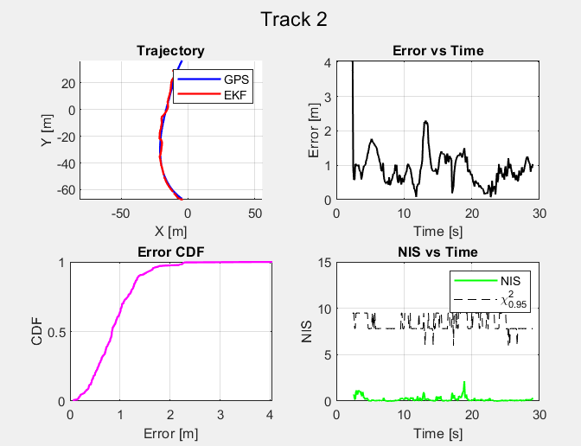
AOA-only EKF — Track2:
2D localization with yaw-corrected azimuth from 10 APs. EKF with constant velocity model. Initial position from robust least-squares estimate. Adaptive noise tuning via NIS (σ² = 0.0320)
AOA-only EKF performs reliably in straight paths with no obstacles. It shows high accuracy, stable tracking, and consistent statistical performance.
Trajectory EKF estimation closely follows the ground truth, with minimal drift. Error vs Time Errors are higher at the beginning but stabilize quickly. Error CDF Over 90% of errors are below 2 m, indicating good accuracy. NIS vs Time Most NIS values stay below the χ² threshold → good model consistency. Peaks are rare and short

Slide 15
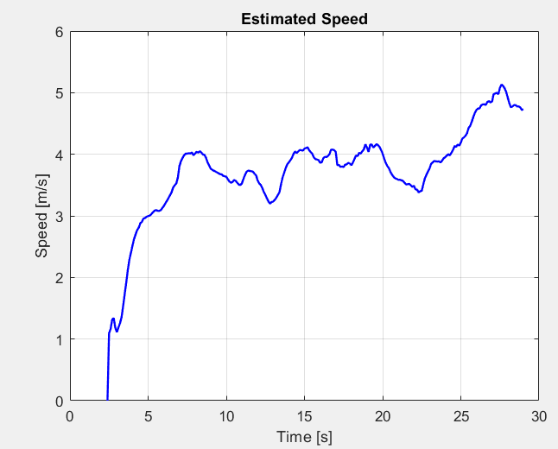
AOA-only EKF — Track 2:
Velocity Estimate Between 5 s and 20 s, the speed oscillates slightly between 3.5 and 4.2 m/s, showing a stable cruising behavior.
The plot is smooth with no sharp jumps, suggesting a well-filtered and reliable velocity estimate
Performance Metrics:
Auto-tuned sigma^2 = 0.0320 (scale = 0.80)
MAE = 0.897 m
RMSE = 1.012 m
95% quantile = 1.657 m
Availability = 91.1 %
Reliability = 99.6 %

Slide 16
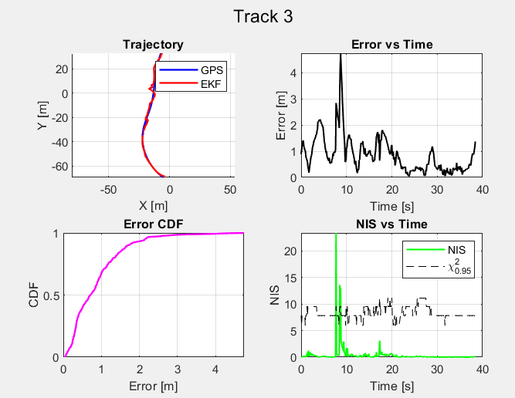
Track 3: (AOA-only EKF)
Trajectory drift is more visible compared to other tracks due to noisy AoA inputs. Error peaks reach above 4 m during early segments; however, tracking stabilizes later. Despite the noise, NIS values mostly stay below the χ² threshold, indicating good filter consistency after initial transients
Trajectory EKF estimation closely follows the ground truth, with minimal drift. Error vs Time Errors are higher at the beginning but stabilize quickly. Error CDF Over 90% of errors are below 2 m, indicating good accuracy. NIS vs Time Most NIS values stay below the χ² threshold → good model consistency. Peaks are rare and short

Slide 17
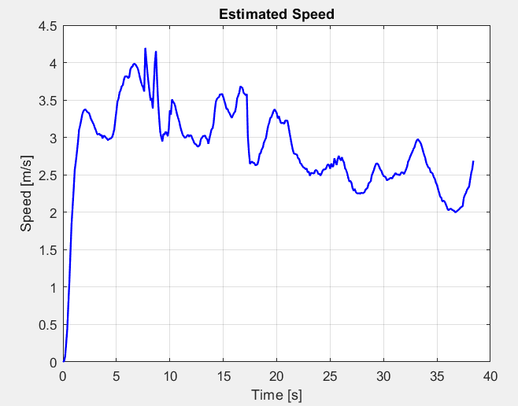
Track 3: (AOA-only EKF)
Velocity Estimate Speed fluctuations around 8–12 s suggest the impact of AoA noise early in the track. Mid-to-late trajectory shows more stable speeds, generally between 2.0–3.5 m/s.
Performance Metrics:
Auto-tuned sigma^2 = 0.0320 (scale = 0.80)
MAE = 0.866 m
RMSE = 1.118 m
95% quantile = 2.156 m
Availability = 98.4 %
Reliability = 98.7 %

Slide 18
AOA-Only EKF: Summary of Results
DOWNLOAD
(EKF) was implemented for 2D localization using measurements from 10 APs, corrected with yaw. The results for all three tracks are summarized below: Performance is consistent across all tracks, with sub-meter MAE and high availability/reliability. The tuned observation noise remained stable (σ² = 0.0320), confirming robustness of NIS-based auto-tuning. Even in (Track 3), accuracy remained reliable.
Track | MAE (m) | RMSE (m) | Q95 (m) | Availability (%) | Reliability (%) | Tuned σ²
1 | 0.896 | 1.16 | 2.124 | 99.4 | 98.6 | 0.032
2 | 0.897 | 1.01 | 1.657 | 91.1 | 99.6 | 0.032
3 | 0.866 | 1.12 | 2.156 | 98.4 | 98.7 | 0.032

Slide 19
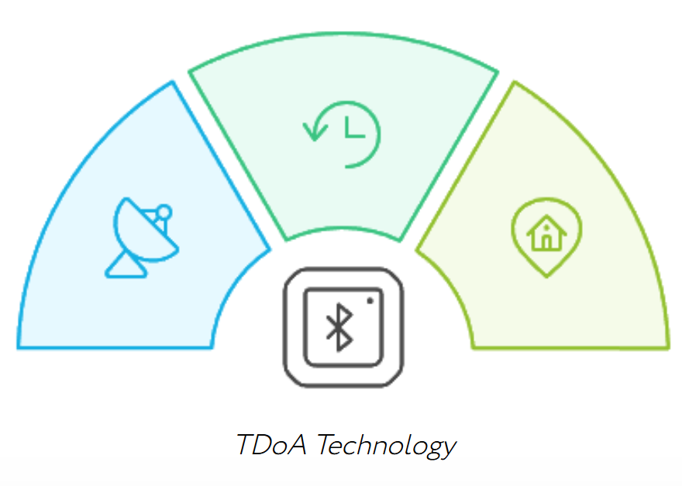
Methodology TDOA-only We implemented a TDOA-only localization method based on least-squares optimization of range-difference measurements between Access Points (APs). A Hampel filter was used to remove outliers from raw estimates. The trajectory was further smoothed using a 2D Kalman Filter with constant velocity dynamics. Performance was evaluated on three test tracks using metrics such as MAE, RMSE, availability, and reliability.

Slide 20
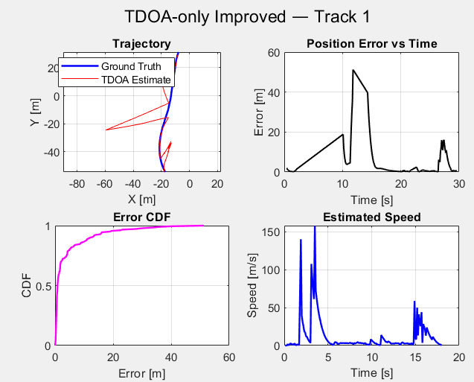
TDOA-only — Track 1: with obstacle
The trajectory shows major drifts, especially early on, due to poor geometry or TDOA errors. Error vs Time reveals bursts over 50 m, indicating localization failures. CDF shows 95% of errors under 19.12 m, with a long tail. Estimated speed has spikes over 100 m/s, highlighting instability and noise.
Metric | Value
MAE | 4.06 m
RMSE | 8.66 m
Q95 | 19.12 m
Availability | 51.13%
Reliability | 72.38%
Despite filtering and Kalman smoothing, the TDOA-only method shows poor performance in obstacle-rich environments. Both accuracy and availability are limited, making this approach unreliable under multipath or missing APs.

Slide 21
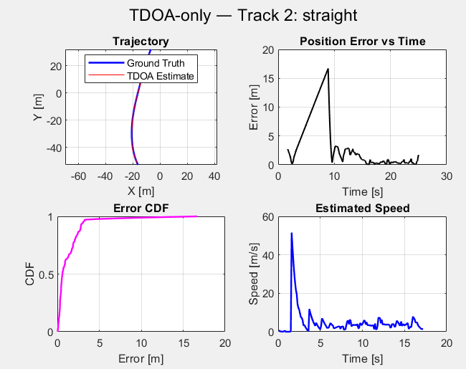
TDOA-only — Track 2: no obstacle
Trajectory aligns better than Track 1, with some early drift.Error peaks at ~17 m initially, then stabilizes below 5 m.CDF shows 95% of errors under 3.09 m.Speed plot has one spike (~50 m/s)
Metric | Value
MAE | 1.31 m
RMSE | 2.34 m
Q95 | 3.09 m
Availability | 59.45%
Reliability | 85.55%
In straight-line motion without obstacles, TDOA-only accuracy and reliability improve notably. However, occasional noise and poor geometry still cause large error spikes, and availability remains limited

Slide 22
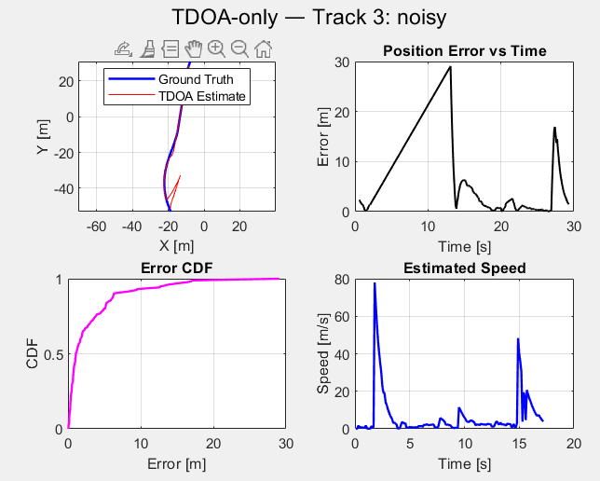
TDOA-only — Track 3
Trajectory partially overlaps with ground truth but diverges later due to degraded measurements. Error grows steadily to \~30 m, showing noise sensitivity. CDF shows high dispersion (Q95 = 13.17 m). Speed plot has unrealistic peaks (\~75 m/s), indicating weak dynamic robustness.
Noisy conditions greatly reduce TDOA-only accuracy. While some localization is recovered, error spikes and low availability reveal its sensitivity to degraded data
Metric | Value
MAE | 2.99 m
RMSE | 5.29 m
Q95 | 13.17 m
Availability | 44.94%
Reliability | 67.05%

Slide 23
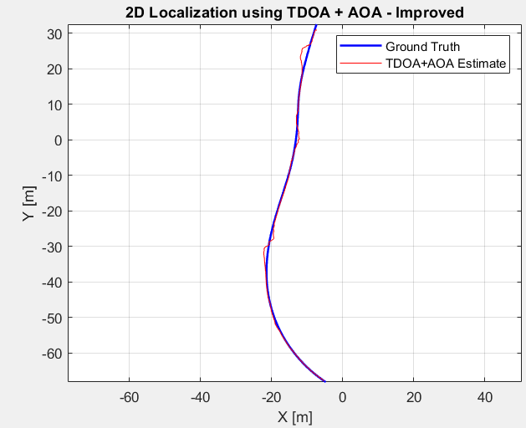
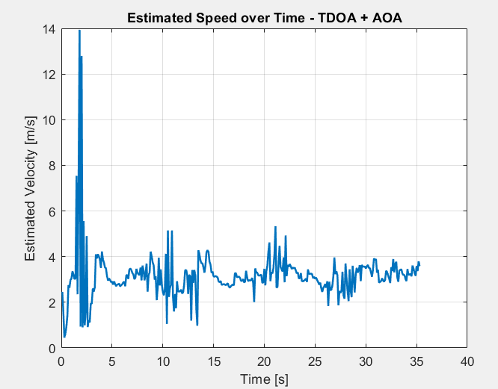
(TDOA + AOA) – Track 1: with obstacle
Methodology
A hybrid least-squares estimator was implemented using both TDOA and AOA measurements. For each time step:
If both TDOA and AOA were available: joint optimization was performed.
Hampel filtering and Kalman smoothing were applied.
Trajectory:
Closely follows ground truth.
Speed Estimate:
Stable, realistic (\~2.5–4 m/s).

Slide 24
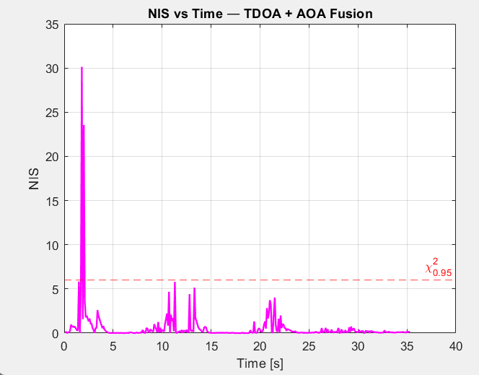
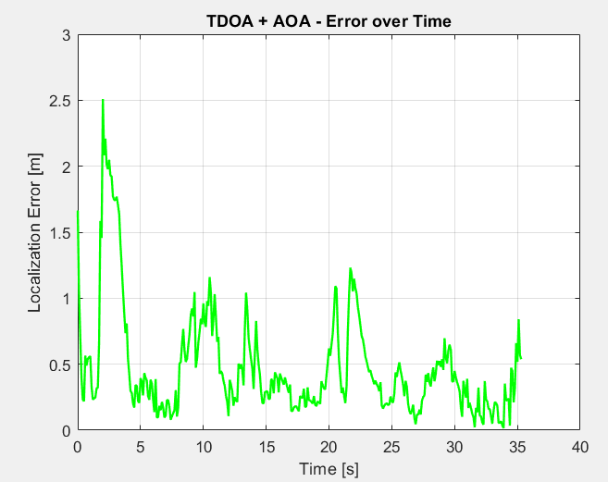
(TDOA + AOA) – Track 1: with obstacle
Error vs Time:
Stays below 1.5 m after initial seconds.
NIS Plot:
Mostly under χ² threshold (\~5.99), confirming consistency.
Performance Metrics:
MAE: 0.48m Reliability: 99.15%
RMSE: 0.68m Availability:100%

Slide 25
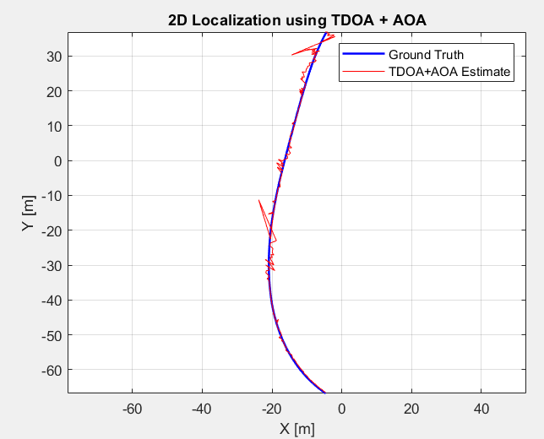
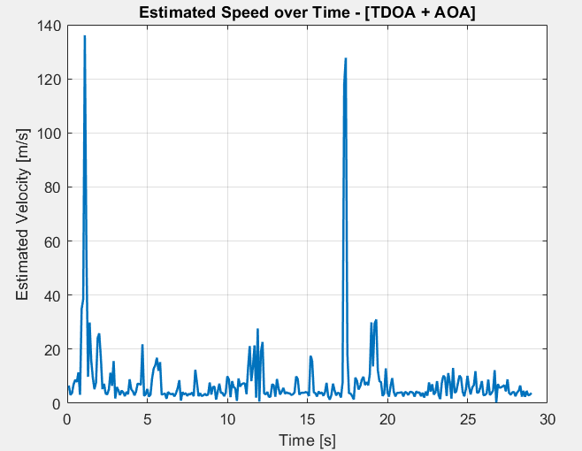
(TDOA + AOA) – Track 2: No Obstacle
Methodology TDOA-AOA fusion method was applied using least-squares optimization on available TDOA and AOA data. A Hampel filter was used to remove outliers, and a constant-velocity Kalman Filter smoothed the trajectory and estimated speed.
Trajectory:
Estimated path closely follows ground truth, with slight mid-trajectory deviations and gaps due to missing or rejected data.
Speed Estimate:
The initial 0–3 s segment shows noisy spikes over 100 m/s, but speed stabilizes afterward, matching expected motion.

Slide 26
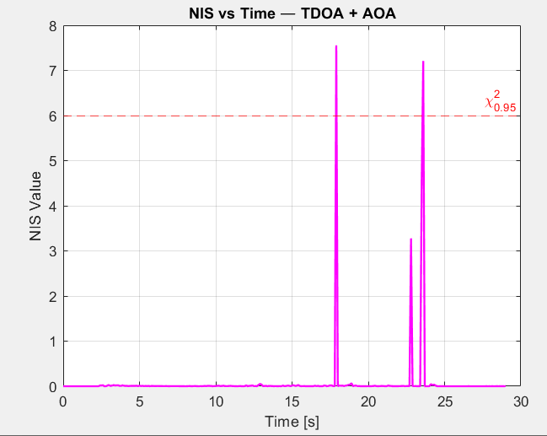
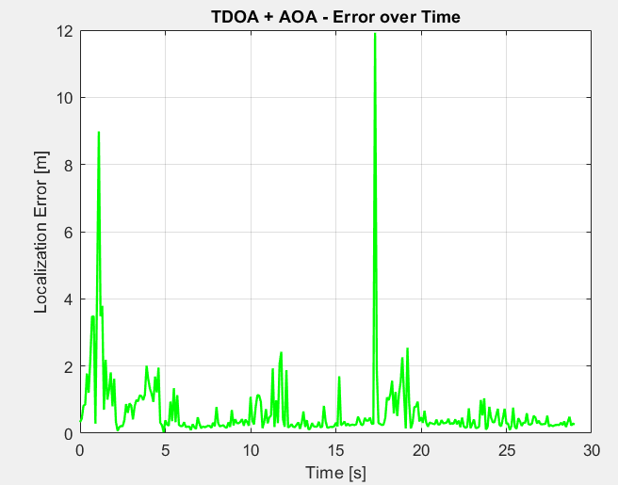
(TDOA + AOA) – Track: No Obstacle
Error vs Time:
Error stays below 2 m for most of the time, with brief spikes (e.g., at 2 s and 17 s) that quickly recover.
NIS Plot:
Most NIS values remain below the chi² threshold, indicating brief mismatches between filter and measurements.
MAE: 0.64m Reliability: 99.31%
RMSE: 1.23m Availability:99.31%

Slide 27
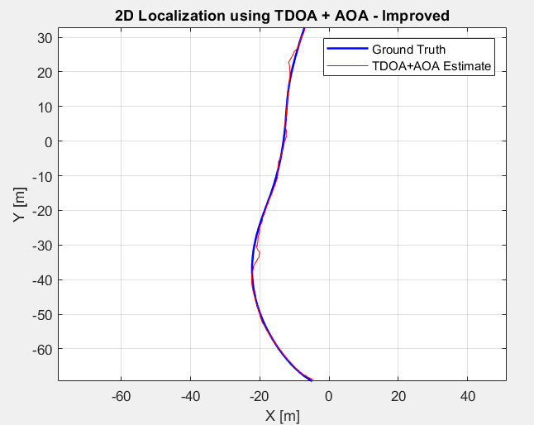
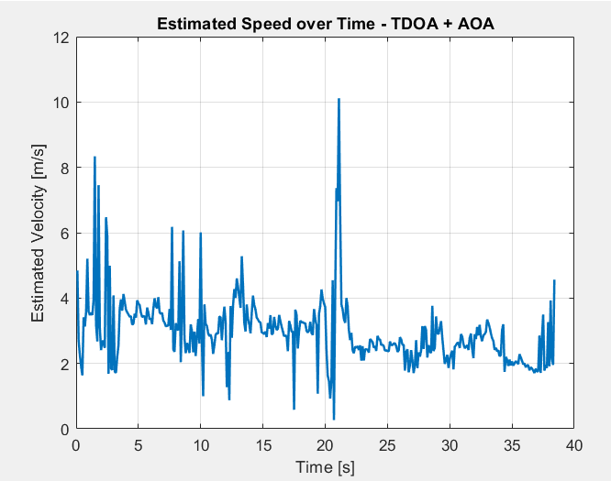
(TDOA + AOA) – Track 3
Trajectory:
Estimated path closely follows ground truth, with minor deviations during turns or sharp maneuvers.
Speed Estimate:
Speed is realistic (~2–6 m/s); isolated spikes occur but are well filtered.

Slide 28
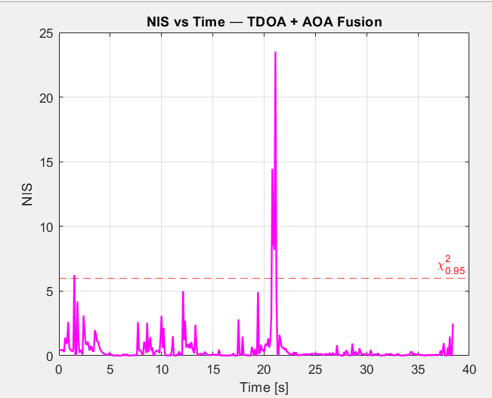
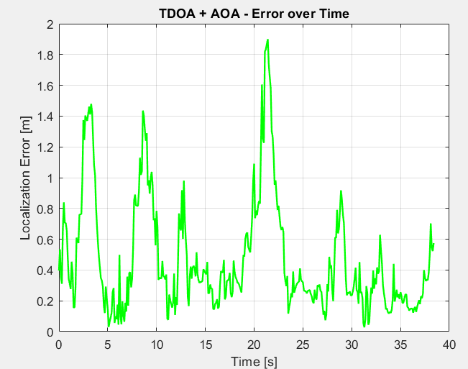
(TDOA + AOA) – Track 3
Error vs Time:
Mostly stays under 1 m; occasional peaks ( ~1.8 m) reflect brief noise
NIS Plot:
Most values are below the 95% χ² threshold (~5.99), confirming high reliability
MAE: 0.47m Reliability: 98.44%
RMSE: 0.60m Availability:100%

Slide 29
Results Comparison of TDOA + AOA Tracks
Track 3 The lowest MAE and RMSE.
Track 2 had the highest RMSE due to larger outliers during straight motion but still maintained high reliability.
Track 1 delivered strong performance with the highest reliability in obstacle- rich settings.
All tracks showed high availability, confirming the effectiveness of the fallback and fusion strategy.
Metric | Track 1 (Obstacle) | Track 2 (Straight) | Track 3 (Noisy)
MAE [m] | 0.48 | 0.64 | 0.47
RMSE [m] | 0.63 | 1.23 | 0.6
Availability [%] | 100 | 99.31 | 100
Reliability [%] | 99.15 | 99.31 | 98.44

Slide 30
Thank You
asal.abbas, mohammadreza.zamani, fatemeh.asadi, sahar.abasi@mail.polimi.it

